Slide 1
Vaping: The Facts
Enabling young people to make informed decisions
Sarah Hepworth, Health Improvement Principal
Tobacco Control Strategy lead, Sheffield City Council & Associate Director of the South Yorkshire Tobacco Control Alliance
John Waldron, Policy and Public Affairs Manager,
Action on Smoking and Health
Updated Oct 2025
Provided by Healthy Cornwall

Slide 2
Teachers’ Toolkit
A presentation to support teachers and safeguarding leads in developing their knowledge on vaping and children and young people. This will also support discussions and debate in the classroom
This toolkit contains:
Teacher knowledge presentation to support lesson planning and equip teachers to be discussion ready
Lesson plan for schools with example activities
Animation on vaping and Children and Young People and Classroom presentation to support discussions and where to access further advice and support
Posters

Slide 3
What is vaping?
Vaping is the use of an electronic device to inhale an aerosol derived from a heated liquid.
The main ingredients are vegetable glycerine and propylene glycol, but most e-liquids also contain nicotine, which must be no more than 2% or 20 mg per ml, as well as small amounts of flavourings.

Slide 4

What is a vape device?
There are a variety of vape devices (which are also known as e-cigarettes). The names and type of devices keep changing and new ones come on to the market frequently. Below are the main types of vapes currently available:
vape bars shaped like a highlighter pen (rechargeable and refillable with e-liquid capsules)
compact pod devices shaped like a flash drive or pebble (rechargeable and refillable with e-liquid capsules)
vape pens with a tank you fill with e-liquid, and a replaceable coil and rechargeable battery
customisable devices with variable power (these are more difficult to use and need more maintenance)
Vaping to quit smoking - Better Health - NHS (www.nhs.uk)

Slide 5
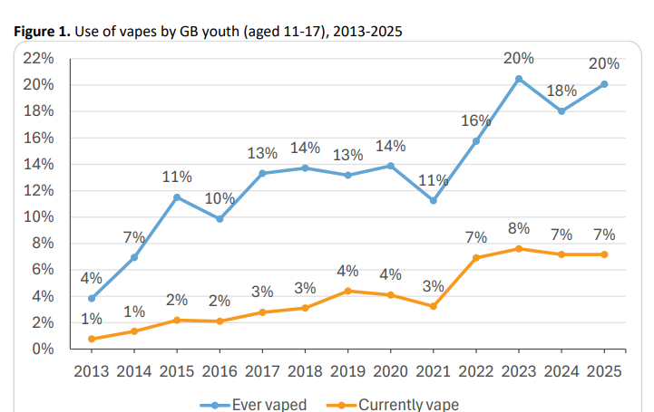
ASH Smokefree GB Youth Survey on vaping among 11–17-year-olds in Great Britain - 2025.
Key findings include:
It remains the case that most children and young people don’t vape or smoke, and rates of vaping have plateaued both for ever tried and current use. However,
20% of 11–17-year-olds have tried vaping, an estimated 1.1 million. This is unchanged since 2023.
7% currently vape , an estimated 400k, with 40% vaping daily, an estimated 160k. Current use has been static since 2022.
Ever smoking among youth increased from 14% in 2023 to 21% in 2025, raising concerns.
Perceived harm from vaping is increasing: 63% of young people (wrongly) believe vaping is as or more harmful than smoking.
Use-of-Vapes-Among-Young-People-in-Great-Britain-2025.pdf

Slide 6
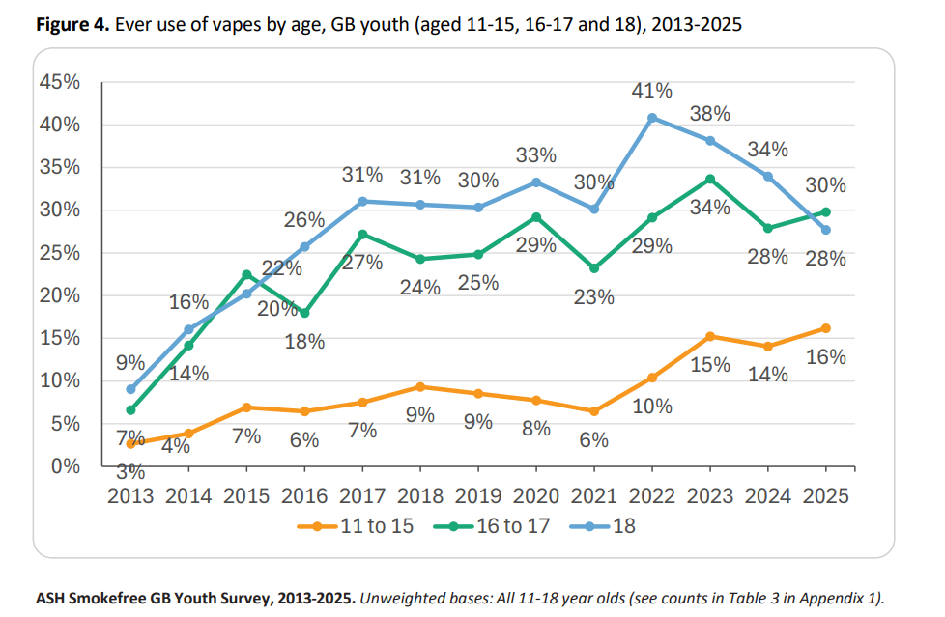
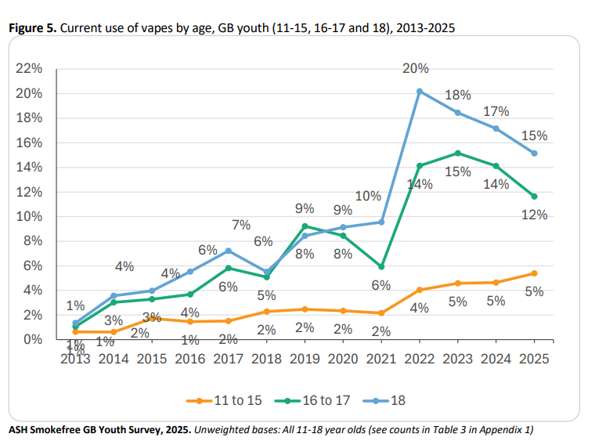
Vaping Prevalence increases with age
Younger teens (11–15) vape far less than older adolescents (16–17), headline figures may not reflect everyday reality in differences in vaping behaviour amongst age groups.
11–15-year-olds: 16% ever vaped; 5% currently vape.
16–17-year-olds: 30% ever vaped; 12% currently vape.
18-year-olds: 28% ever vaped; 15% currently vape. Vaping amongst 18-year-olds has fallen significantly.

Slide 7
Vaping by Smoking Status
49% of 11–17-year-olds who currently smoke also vape, compared with 27% of those who vape who have stopped smoking.
Among the 77% of 11–17-year-olds who report never having smoked 10% have tried vaping and 2% currently vape.

Slide 8
Smoking vs vaping
Smoking is much more harmful than vaping. Tobacco smoke contains 7,000 chemicals including carbon monoxide and tar, and a sticky soup of around 250 toxic chemicals (more than a quarter of which are known to be carcinogens), causing disease, disability, and early death.

Slide 9
Vapes are not harmless
The levels of exposure to cancer causing and other toxicants are extremely low in people who vape compared with those who smoke but there is still some exposure.
The developing lungs of children and young people may mean they are more sensitive to the effects of vaping. Which is why it is not for children.
Short-term effects can include coughing, headaches, dizziness and sore throats.
The long-term effects are, as yet, unknown.
Vaping is an effective way for adults to stop smoking– but is not recommended for non-smokers and particularly children and young people.

Slide 10
Nicotine vapes and dependency in children and young people
Most vapes contain nicotine, which is addictive and can be hard to stop using once you have started, this is another reason why vapes should only be used by adults as a tool to stop smoking or reduce harm from tobacco.
As the numbers of children and young people who smoke or vape are quite small this makes it difficult to draw conclusions about patterns in their dependency behaviour.
However, it appears that young vapers are becoming more dependent on vapes than in previous years. 26% of vapers reported strong, very strong or extremely strong urges to vape in 2020, compared with 47% in 2025.
In 2025, 56% of smokers reported strong urges to smoke, demonstrating similar levels of dependency among smokers and vapers.
It’s important to note that cigarettes still carry the highest risk of addiction as they are designed to maximise nicotine intake and contain other chemicals that reinforce the addictiveness of nicotine.

Slide 11
How do nicotine vapes help smokers quit?
The rapidly delivery of nicotine to the brain makes smoking highly addictive.
Cravings for nicotine among those addicted can make people feel stressed, restless, irritable and unable to concentrate.
Like nicotine patches and gum, vapes containing nicotine are a useful aid to quitting as they deal with the cravings smokers get when they try to stop.
Nicotine vapes help smokers quit by replacing some of the nicotine they used to get from cigarettes and also by mimicking the hand-to-mouth action of smoking.
Notes:
Add with concerns about vaping

Slide 12
How do nicotine vapes help smokers quit?
Nicotine replacement therapy such as gum and patches are licensed by the Medicines and Healthcare products Regulatory Agency for smoking cessation, not just by adults but also by children from age 12 upwards.
Nicotine vapes are not licensed as medicines but are proven effective and have become the most popular quitting aid for smokers in recent years.

Slide 13
How much nicotine is there in vapes compared to cigarettes?
Someone using a vape with the highest nicotine strength will absorb around 20 mg of nicotine, compared to 20/30mg for someone smoking a 20 pack of cigarettes.
For both smoking and vaping, a small proportion of the nicotine content is absorbed by the user and depends largely on how a cigarette or vape is used, rather than what it contains.
While nicotine is the addictive component in tobacco, the vast majority of the harm from smoking comes from other chemicals in tobacco smoke like tar and carbon monoxide.

Slide 14
The Tobacco and Vapes Bill (2024)
The Tobacco and Vapes Bill (2024) is crucial to protecting children and young people.
Not only will the bill create the first smokefree generation it will further regulate vapes and vape products. The bill will give the government powers to stop vapes and other consumer nicotine products (nicotine pouches) from being deliberately branded and advertised to appeal to children and young people.

Slide 15
Tobacco and Vapes Bill 2024
New policy measures will:
Prohibit branding on vapes appealing to children, such as sweet names and bright colours.
Prohibit the handing out of free vapes to children.
Regulate vape contents and flavours, restricting flavours that appeal to children e.g. Gummy bear
Regulate vape displays and promotion in shops, putting vapes behind the counter so they are out of sight
Create retail licensing and registration schemes for the sale of tobacco, vapes and non-medicinal nicotine products.
Prohibit vaping in some smokefree places (exact locations tbc).
Banning vape advertising and sponsorship and vape vending machines.
Regulating vape product design.
Regulate zero nicotine vapes and other nicotine products like pouches which currently do not have age of sale restrictions.
These measures will be introduced gradually over the next few years, and the detail of some measures still needs to be finalised as the bill goes through parliament.
The Tobacco and Vapes Bill - ASH

Slide 16
Illegal Vapes
There is currently a market for illegal vapes. Too many children and young people are being sold both legal and illegal vaping products.
Trading Standards services within local authorities are primarily responsible for enforcement and dedicated resources are in place to support this.
Illegal vapes may contain banned ingredients or exceed restrictions on nicotine content. People who want to quit smoking using a vape are advised to only use legal regulated products from a reputable retailer.
Trading Standards rely on intelligence from the community so do report any information you have about where children are accessing vapes. Trading Standards can also take action against those selling illegal tobacco.
Any concerns around safeguarding should be reported immediately via appropriate local routes.

Slide 17
Illegal sales of vapes
The Tobacco and Vapes Bill will strengthen enforcement activity, allowing Trading Standards to take swifter action to enforce the law including on non-compliant vaping products, and closing loopholes in the law. Further protecting our children and young people and reducing the chances of them getting hold of vapes illegally.
The Bill will establish a retailer licensing scheme by giving the government the legal powers and regulatory framework to create, enforce, and manage a system where retailers must be licensed to sell tobacco, vapes, and nicotine products.
It will also introduce a new £200 fixed penalty notice which will enable Trading Standards Officers to act ‘on the spot’ to clamp down on offences such as underage sales.
Additionally, a new tax will be placed on vaping products from October 2026 to make vapes less affordable and give greater powers to HMRC and Border Force.
If you know of anyone who sells vapes or tobacco illegally, you can report them to trading standards either via the local council or through the Citizens Advice online portal: www.citizensadvice.org.uk/consumer/

Slide 18
Question!
Why do you think children try vaping?

Slide 19


Reasons for vaping by smoking status
Most frequent reason given for vaping was to just give it a try. 60% of never smokers and 30% of ever smokers.
The next reason being other people use them, so I join in, 12% of never smokers and 10% of ever smokers
ASH/YouGov Smokefree GB Youth Survey 2025 (ever smoker includes anyone who has ever smoked)

Slide 20
Social, family and peer influences
Vaping is commonly described as a social activity by young people, often occurring in group settings such as parties or social gatherings.
Peer influence, social media, and the desire to bond with peers through shared experiences like “tricks” is seen as important.
Many young people associate vape use with a desire to fit in with their peers, often justifying their own use based on the perceived high prevalence of vaping among their social circles. They feel compelled to use vapes because “everyone else does” and viewed vapes as “cool” or “trendy”.
Many young people report vaping to help with mental wellbeing such as with social anxiety.
Both young people and school staff have reported vaping having an impact on concentration and behaviour in school.
Many young people report viewing vaping and smoking as completely different. Smoking not seen as cool.
Research shows that parents may also influence children’s perceptions and use of vapes. Children who lived with someone who vaped were more knowledgeable and accepting of vaping products and were more likely to express intentions to vape as adults.
Notes:
Understanding and Preventing Youth Vaping in the UK | BSPHN
Young people’s experiences of vaping in their community: a co-created study between embedded researchers and local authority public health practitioners – PMC
poster-adph-sli-pdf-1.pdf

Slide 21
Question!
Where do you think children and young people who vape get them?

Slide 22
Most common source of vapes for 11-17-yr-olds is being given them or purchasing in a shop
ASH/YouGov Smokefree GB Youth Survey 2025
Notes:
. The sale of tobacco and vapes to people under the age of 18 is an offence, however purchase from shops is common with 46% of 11-17 year olds who currently vape purchasing from shops, and 47% of smokers (Figure 21). A substantial proportion of current vapers buy from an informal source (25% for vapes and 20% for cigarettes) even though proxy purchase, buying on behalf of someone else, is also illegal. Online purchases are much less frequent, with 10% of current vapers citing this as a source and 9% of smokers. Street markets are a more common source of cigarettes (20%) than vapes (5%).

Slide 23
Question!
Where is vaping being promoted online?

Slide 24
11–17-year-olds who had seen e-cigarettes promoted online, where did they see them in 2025
Of those who reported seeing vapes promoted online the most common place was on TikTok (42%), followed by YouTube (33%) and Instagram (30%).
ASH/YouGov Smokefree GB Youth Survey 2025

Slide 25
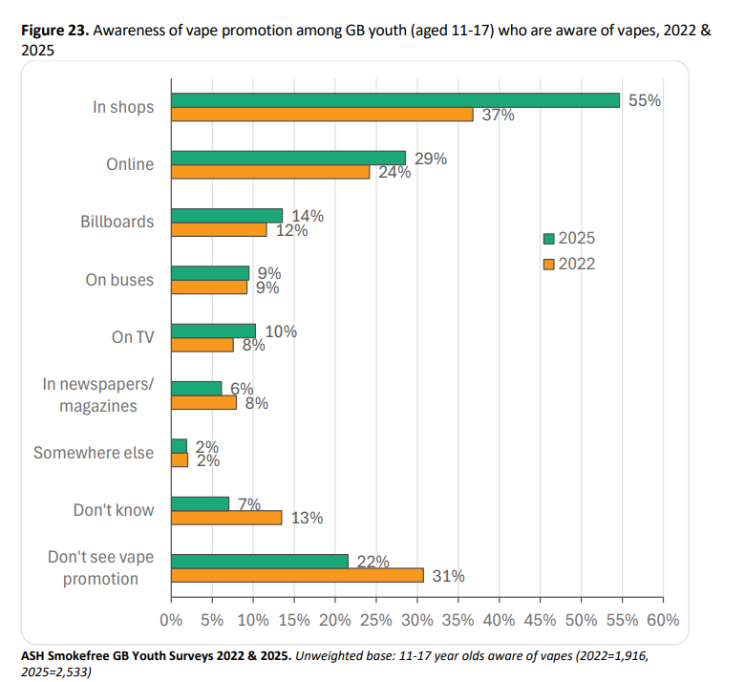
Youth awareness of vape promotion highest in shops
There has been a significant increase in awareness of promotion of vapes between 2022 and 2025, particularly in shops (37% in 2022, 55% in 2025) and a decline in those saying they don’t see vapes being advertised.
ASH/YouGov Smokefree GB Youth Survey 2025
Notes:
Figure 23 shows how the awareness of vaping promotion has grown among 11-17 year olds between 2022 and 2025. There has been a significant increase in awareness of promotion of vapes over these years, particularly in shops (37% in 2022, 55% in 2025) and a decline in those saying they don’t see vapes being advertised.
In 2022, 56% of 11-17 year olds who are aware of vapes report they were exposed to some form of vape promotion. In 2025, 71% reported having seen vape promotion, the most common type being in shops (55%) and online (29%).

Slide 26
The law and vaping
Vapes and vaping products containing nicotine, like tobacco, are age restricted. It’s illegal to sell them to under 18s, and for adults to buy them on their behalf.
Those who knowingly sell vapes to under 18s don’t care who they sell to and whether the products they sell are illegal they are just interested in making money.
If you know of anyone who does sell vapes, or tobacco illegally, you can report them to trading standards through the Citizens Advice online portal: www.citizensadvice.org.uk/consumer/

Slide 27
Regulation of vapes to protect health
In the UK we have tight regulations around the strength of nicotine allowed in vapes and they must carry health warnings on the packaging E-cigarettes: regulations for consumer products - GOV.UK (www.gov.uk).
Vaping products containing nicotine are regulated by the Medicines and Healthcare products Regulatory Agency (MHRA), which provides advice for consumers.
Sales to those under 18 are illegal, but to be legally sold in the UK nicotine containing e-cigarettes must also:
  Contain 20 mg/ml or less of nicotine (equivalent to 2% or less)
  Carry the health warning ‘This product contains nicotine which is a highly addictive substance”.
  Be notified to the MHRA and listed on its website.
  There are a number of ingredients which are prohibited in nicotine-containing e-liquid, including vitamins, stimulants such as caffeine or taurine, colourings and chemicals which are carcinogenic, mutagenic and reprotoxic in their unburnt form.

Slide 28
Advertising
Advertising of all tobacco products is illegal.
Advertising of nicotine-containing vaping products is prohibited on broadcast media (TV and radio); and in newspapers, magazines and periodicals; online media and some other forms of electronic media (this includes social media).
If you see advertising for vapes that you feel is trying to encourage children and young people to try vaping, you can report it to the Advertising Standards Authority www.asa.org.uk.
Non-commercial public health campaigns promoting vaping as an alternative to smoking are permitted.
Vape advertising will be banned by the Tobacco and Vapes Bill.

Slide 29
Diacetyl and Popcorn Lung
  Despite reports in the media, there have been no confirmed cases of popcorn lung linked to vapes.
  Some vapes were found to contain diacetyl but in very small quantities, not the large quantities associated with ‘popcorn lung’.
  However, as a safety precaution it was banned from vapes in the UK and EU in 2016 along with other ingredients that pose a risk to human health.
  See the Cancer Research UK mythbuster on vaping and popcorn lung Does vaping cause popcorn lung? | Cancer Research UK

Slide 30
Ban on Single Use Disposable Vapes
From 1 June 2025, it has been illegal for businesses to sell or supply all single-use or ‘disposable’ vapes. This applies to sales online and in shops and all vapes whether they contain nicotine or not.
Banning disposable vapes will not only protect the environment but will importantly reduce the appeal of vapes to children.
Single-use vapes (also known as disposable vapes) are an inefficient use of critical resources and are often discarded as litter or thrown away and not-recycled.
In England, Trading Standards will apply civil sanctions to businesses – including the possibility of a £200 fine – in the first instance. Repeated non-compliance could result in an unlimited fine or prison sentence of up to two years.
Single-use vapes ban - GOV.UK

Slide 31
How does vaping impact the environment ?
Over 8 million vapes are thrown away every week or recycled incorrectly
Vapes contain batteries and difficult-to-recycle plastics that break down in landfills.
Vapes should be recycled using a recycling scheme rather than placed in general household waste.
Like tobacco and cigarette butts, vapes contain chemicals that can pollute the soil and water.
Up to 80% of materials in vapes can be recycled
It is important to recycle vapes - Find a local recycling point

Slide 32
What about the impact of tobacco on the environment?
Tobacco growing, curing and manufacturing pollutes the environment, causes soil degradation, biodiversity losses, and deforestation.
Tobacco cigarettes are the most littered item and the toxic chemicals they contain pollute our pavements, parks, soil, rivers, and the sea with devastating consequences.

Slide 33
Impact of tobacco on the environment
Globally the tobacco industry manufactures the equivalent of six trillion cigarettes each year, using 5.3 million hectares of land.
Every year tobacco costs more than 8 million human lives, and 600 million trees, and 4.5 trillion cigarette filters pollute our pavements, parks, soil, rivers, beaches and oceans.
Tobacco produces 25 megatons of solid waste, 55 megatons of waste water, almost 84 megatons of CO₂ emissions to climate change – approximately 0.2% of the global total.
More information:
WHO. Tobacco: poisoning our planet. 29 May 2022

Slide 34
Supporting families to become smokefree
We need to encourage parents and carers who smoke tobacco to quit
When a cigarette burns it gives off thousands of toxic chemicals to anyone inhaling it directly or indirectly – known as secondhand smoke
Children who live with someone who smokes tobacco are around three times more likely to become smokers themselves, compared to children from non-smoking households.
Children who are subjected to secondhand smoke are more likely to develop headaches and nausea, asthma, chest infections like pneumonia and bronchitis, meningitis, ear infections, coughs and colds
For adults, both smoking and secondhand smoke raises the risks of lung cancer, heart disease and stroke, COPD asthma and dementia. There are also risks to unborn babies.
Quitting smoking means parents and carers are less likely to become unwell, be off work and lose out financially – quitting will make them healthier and better off, as well as protect their families from secondhand smoke
Lots of options available to quit tobacco, including quitting aids, switching completely to vaping and getting support from the local stop smoking service. Quit smoking - Better Health - NHS

Slide 35
Classroom discussion
Key questions:
What do they know about smoking?
  …and what do they know about vaping…?
  …what is the difference?
Why do they think young people smoke or vape?
What impact does smoking or vaping have on their lives?

Slide 36
Classroom discussion
Key questions:
Discuss the different reasons why children may smoke or vape – give examples such as wanting to fit in socially, curiosity, social anxiety, aligning with own social group, stress, perceived kudos, peer pressure (direct/indirect).
Talk through effective ways to respond if they ever feel pressured to try either and practise responding together. More information can be found here to support these conversations - Feeling pressured to take drugs? Here are 10 ways to deal with it | FRANK (talktofrank.com).
Explain the facts.
Discuss why nicotine vapes are not for non-smokers and children and young people but
are an effective quitting aid for adult smokers.
Direct young people who have concerns to talk someone they trust and can be honest with, a teacher, parent or friend.

Slide 37
Support and Advice
If a young person confides that they are a smoker or a vaper try to understand why they are smoking or vaping by asking questions like “What do you enjoy about smoking or vaping?” Or “How does smoking or vaping make you feel?”. Understanding this might help you to understand their needs and discuss other ways to meet their needs.
Make a referral, where appropriate, to the school nurse, pastoral lead, safeguarding lead who can then seek support re: vaping or stopping smoking.
Additionally, children and young people can be directed to Talk to FRANK www.talktofrank.com or can call 0300 123 6600 (24 hours a day, 7 days a week) for friendly and confidential advice.
Provide information on the school smoking and vaping policies – young people should not be excluded from school for vaping or smoking, unless it is associated with other disruptive behaviour which justifies this.

Slide 38
Further reading and helpful info
www.smokefreesheffield.org
https://ash.org.uk/key-topics/vaping-what-you-need-to-know
https://ash.org.uk/key-topics/youth-vaping
https://ash.org.uk/resources/view/use-of-e-cigarettes-among-young-people-in-great-britain
https://ash.org.uk/resources/view/addressing-common-myths-about-vaping-putting-the-evidence-in-context
NCSCT resources on young people and quitting vaping https://www.ncsct.co.uk/publications/young-people-stopping-vaping
Vapes | FRANK (talktofrank.com)
https://www.gov.uk/government/publications/nicotine-vaping-in-england-2022-evidence-update
If you know of anyone who does sell vapes or tobacco illegally, you can report them to trading standards either via the local council or through the Citizens Advice online portal: www.citizensadvice.org.uk/consumer/

