Slide 2
What do you know about smoking and vaping?

Slide 3
Smoking causes disease, poor health and early death.

Slide 4

Many adult smokers switch to nicotine vapes to help them quit smoking.

Slide 5

Most young people don’t vape or smoke.

Slide 6
Vaping is less harmful than smoking because you don’t inhale the toxic tar and carbon monoxide found in tobacco smoke.

Slide 7
However, vapes are
not harmless.

Slide 8
The developing lungs of children and young people may mean they are more sensitive to the effects of vaping. Which is why it is not for children.

Slide 9

Short-term effects of vaping can include coughing, headaches, dizziness and sore throats.
Notes:
See slide 12 of the Teachers’ Toolkit

Slide 10


And the long-term effects are, as yet, unknown.

Slide 11
Also, most vapes contain nicotine, which is an addictive substance that can be hard to stop using once you have started.

Slide 12
Vapes and vaping products are age-restricted.
Notes:
See slides 19 and 20 of the Teachers’ Toolkit

Slide 13
It’s against the law to sell them to anyone under 18.
It’s also illegal for adults to buy vapes for anyone under 18.

Slide 14

Anyone who knowingly sells vapes to under 18s is driven by profit and doesn’t care who they sell to or whether the products they sell are legal.
If you know of anyone who does sell vapes or tobacco illegally, you can report them to trading standards either via the local council or through the Citizens Advice online portal: www.citizensadvice.org.uk/consumer/
Notes:
Ask the students what they could do or who they can tell if they know of anyone selling vapes to young people.

Slide 15
Illegal vapes may contain banned ingredients or exceed restrictions on nicotine content.

Slide 16
People who want to quit smoking using a vape are advised to only use legal regulated products from a reputable retailer.

Slide 17
Why do you think some young people vape?

Slide 18
What impact do you think vaping has on their lives?

Slide 19
The environmental impacts of vapes

Slide 20



Vapes can have an impact on the environment if they are not disposed of properly
Notes:
Ask the students what they think the environmental impact is of using vapes?

Slide 21
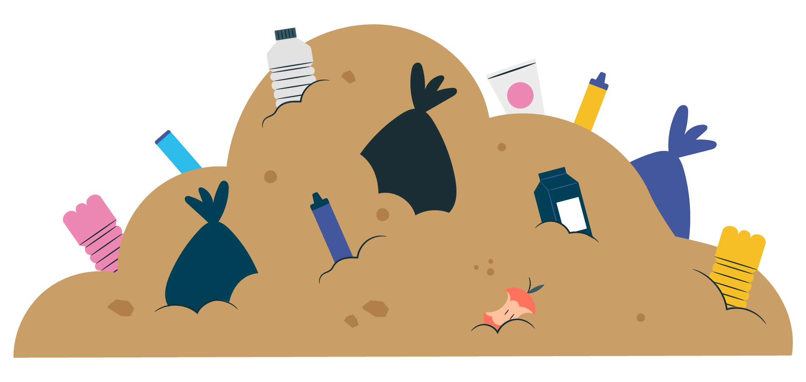
Vapes contain batteries and difficult to recycle plastics that break down in landfills.
Vapes should be recycled using a recycling scheme rather than placed in general household waste.
Like tobacco and cigarette butts, vapes contain chemicals that can pollute the soil and water.

Slide 22
Over 8 million vapes are thrown away every week or recycled incorrectly.
It is important to dispose of vapes properly.
Up to 80% of materials in vapes can be recycled.
Recycle vapes - Find a local recycling point

Slide 23
On the 1st of June 2025 a Ban on Disposable Vapes came into force in England.

Slide 24
How do the impacts of tobacco on the environment compare
to vapes?

Slide 25

The tobacco supply chain is extremely environmentally harmful on a global scale. Environmental impact at all stages:
Cultivation/ farming
Curing
Primary processing
Manufacturing
Distribution
Use/ disposal

Slide 26
These result in:
Pollution
Soil degradation
Biodiversity losses
Deforestation
and
Death: Tobacco kills 8 million people a year globally

Slide 27
Around six trillion cigarettes are manufactured each year globally using 5.3 million hectares of land and 600 million trees.
Cigarettes are the most littered item on the planet with 4.5 trillion cigarette butts polluting our pavements, parks, soil, rivers, beaches and oceans.
Notes:
More information:
Zafeiridou et al. 2018). https://doi.org/10.1021/acs.est.8b01533.
https://ash.org.uk/uploads/Tobacco-Environment.pdf

Slide 28


Advice and support
If you want to learn more or have concerns talk to someone you trust and can be honest with, a teacher, parent, or friend.
Or visit Talk to FRANK talktofrank.com or call 0300 123 6600 (24 hours a day, 7 days a week) for friendly and confidential advice.
Visit Healthy Cornwall www.healthycornwall.org.uk/smokefree
If you know someone giving or selling vapes to you or your friends, you can report them anonymously at www.vapeanon.com

